Slide 1

LECTURE-2
BT101- Introductory Biology
Dr. Kusum K. Singh
Department of Biosciences and Bioengineering
Indian Institute of Technology Guwahati

Slide 2
Chromosomes
Contents:
Gregor Mendel (1865) inheritance factors.
Walther Flemming “discovery of chromosomes”
Theodor Boveri “Chromosome diminution”
Walter Sutton “Chromosome individuality”
Thomas Hunt Morgan “Chromosomes: physical carriers of hereditary.”
Heinrich Waldeyer
Chromosome theory of inheritance

Slide 3
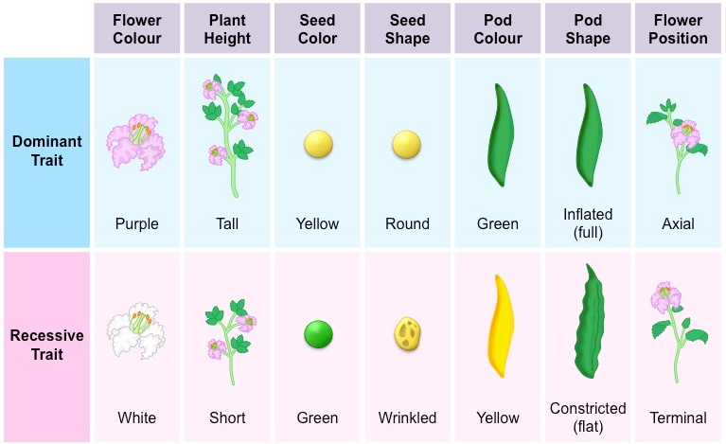
Chromosomes
Gregor Mendel 1865: “Principle of Inheritance”

Slide 4
Chromosomes
“Physical nature of Inheritance”
By 19th century, cells from cells.
Hereditary information = nucleus.
Microscope provide= poor resolution= fix cells= stains.
Stains= enhance contrast.
Innovative microscopy technique = painstaking precision
Walther Flemming = explored fibrous network & named chromatin = stainable materials.
Term “chromosomes” = “Heinrich Waldeyer”
Chrom = color somes= bodies (color bodies)

Slide 5
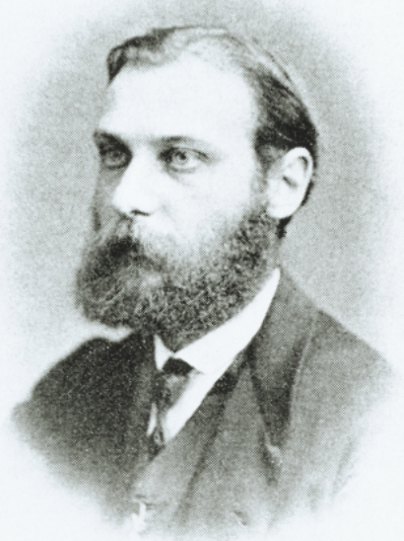
Discovery of Chromosome
German anatomist, born 1843 in Mecklburg.
Discovered chromosomes 1874-1882.
Scaffold & networks transform in “threads”
Studied cell division, mitosis.
Described the cell division steps in detail.
His drawings attracted students and made life visible on board.
Walther Flemming

Slide 6
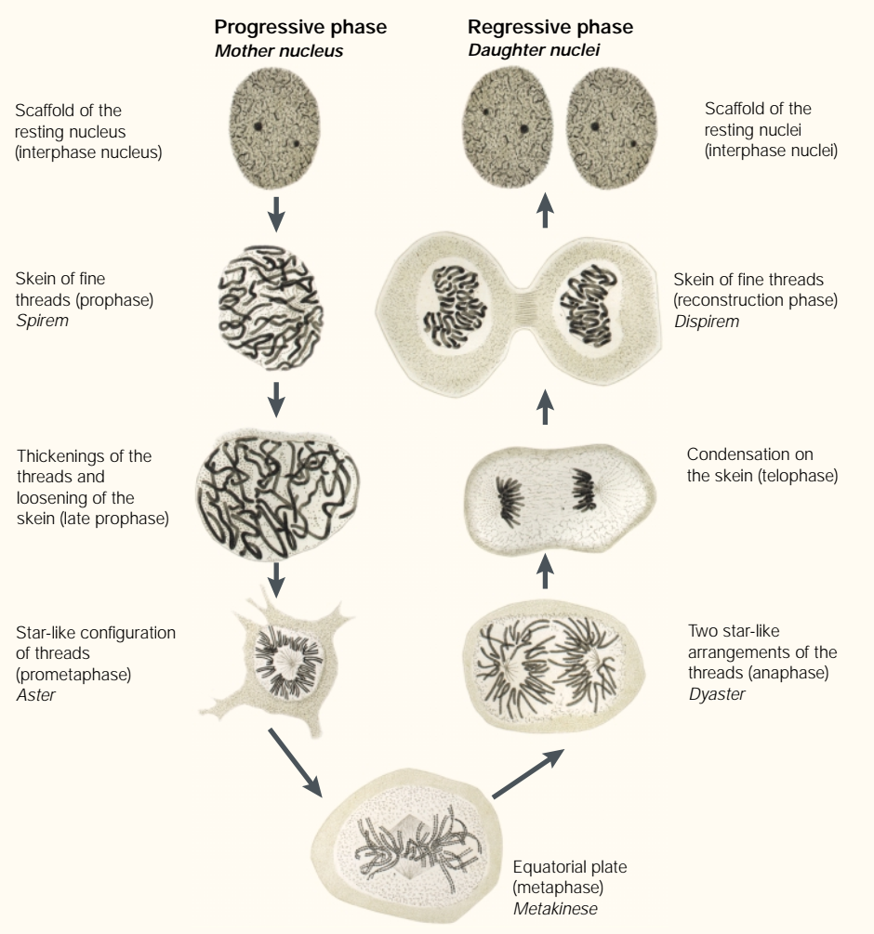
Progressive and Regressive phase

Slide 7
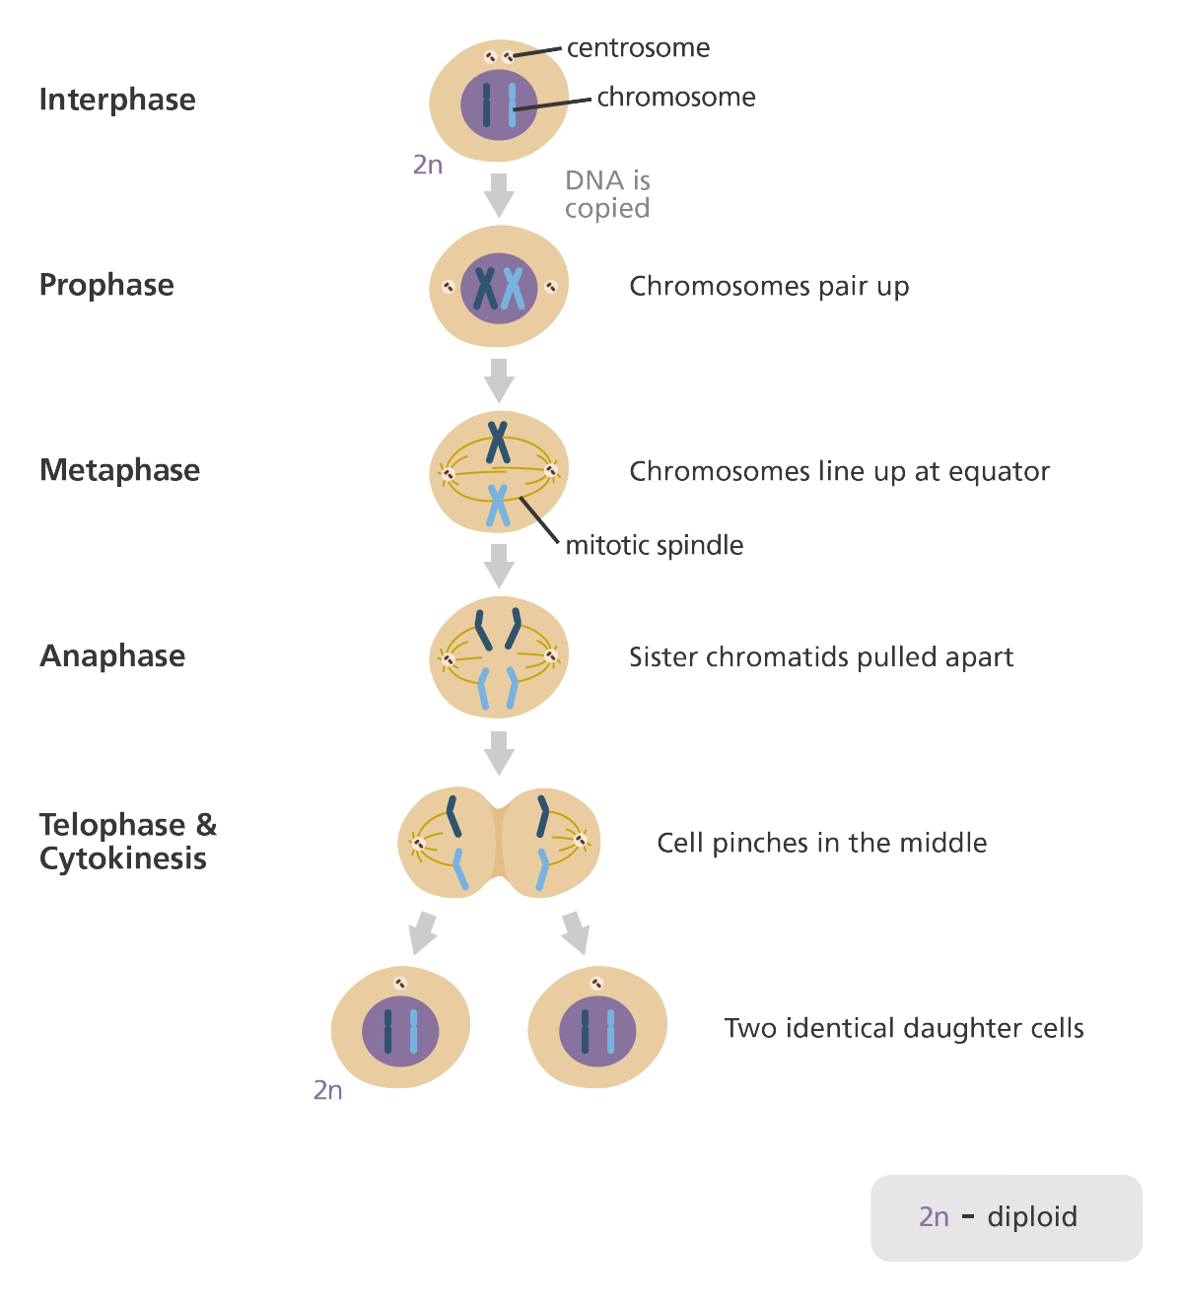
Mitosis (somatic cells)

Slide 8
Discovery of Chromosome
Flemming’s solution for fixation.
Many new field emerged mitosis research, cytology, kinetochores, telomeres, spindle formation etc.
Died from neurological problem at the age of 65 in year 1905.
Walther Flemming

Slide 9
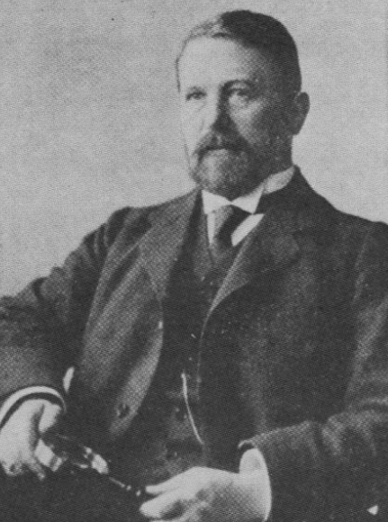
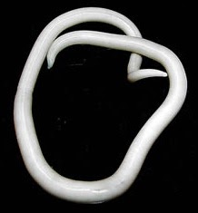
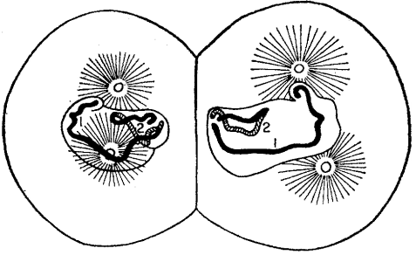
Chromosomes
Chromosome theory of inheritance:
German embryologist, 1862 in Bamberg.
He studied chromosomes and followed its movement during cell division.
Ascaris megalocephala
Theoder Boveri

Slide 10
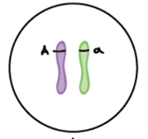
Chromosomes
Chromosome theory of inheritance:
Ascaris develop distinct somatic and germ cells.
Full complement of chr. retained in somatic cells.
Theoder Boveri

Slide 11
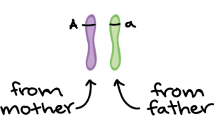
Chromosomes
Chromosome theory of inheritance:
Egg and sperm chr. following fertilization.
A normal 4 chr. was restored following fusion.
Theoder Boveri

Slide 12

Chromosomes
Chromosome theory of inheritance:
Germ cells underwent chr. elimination/diminution.
Theoder Boveri

Slide 13
Chromosomes
Chromosome theory of inheritance:
Ascaris develop distinct somatic and germ cells.
Full complement of chr. retained in somatic cells.
Germ cells underwent chr. elimination/diminution.
Egg and sperm chr. following fertilization.
A normal 4 chr. was restored following fusion.
This was the first evidence of meiosis process.
Theoder Boveri

Slide 14
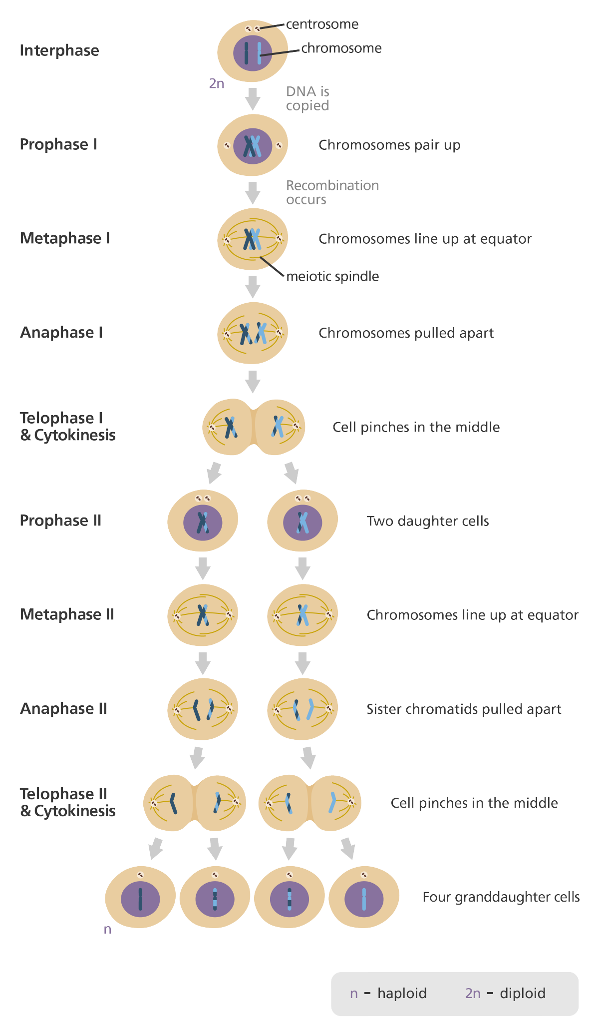

Slide 16
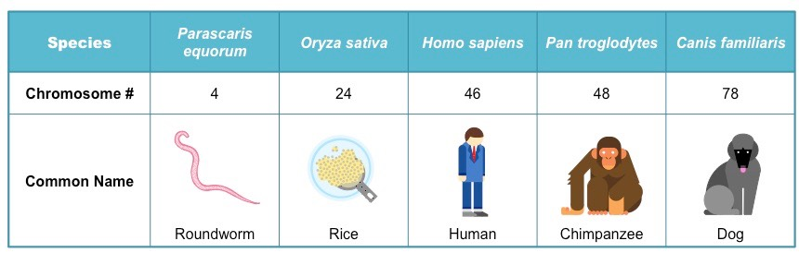
Chrmosomes
Chromosome Number:

Slide 17
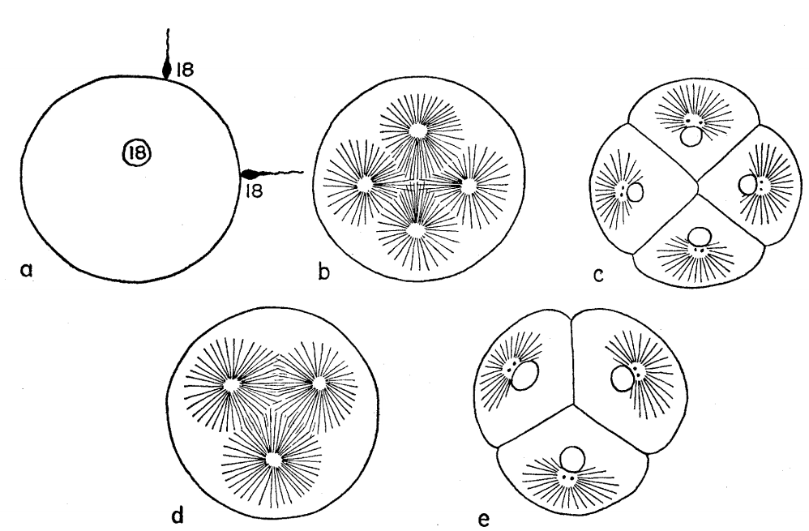
Chromosomes
Chromosome theory of inheritance:
This was the first evidence of meiosis process.
His work on sea urchin laid importance of chr. defects / unequal cell division.
Theoder Boveri

Slide 18
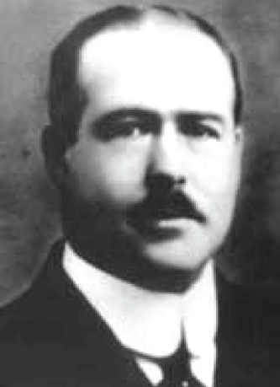
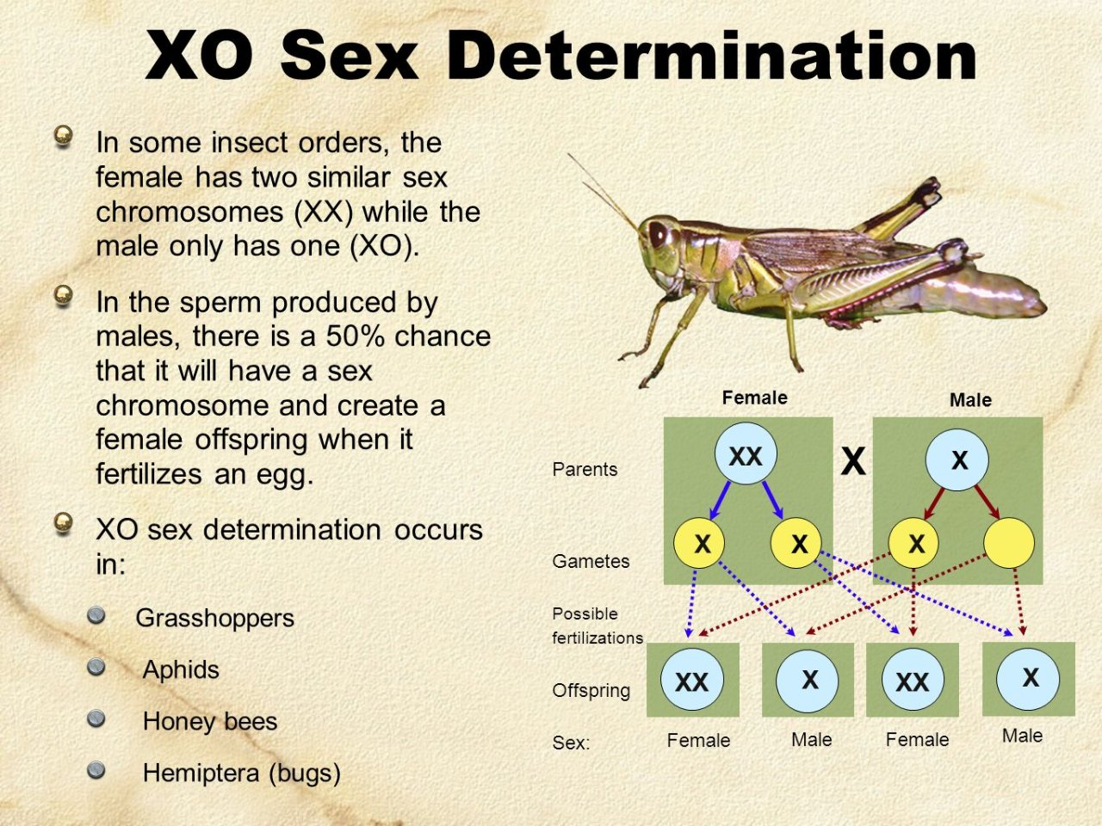
Chromosomes
Chromosome theory of inheritance:
An American scientist, engineer, cytologist, medical doctor, born 1877, in Utica, NY.
Worked on Brachystola magna (grasshopper).
He distinguished individual chromosomes in cells undergoing meiosis.
Chr. have morphological individuality. i.e. all chr. have stable structure or individuality that’s maintained between generations.
Walter Sutton

Slide 19
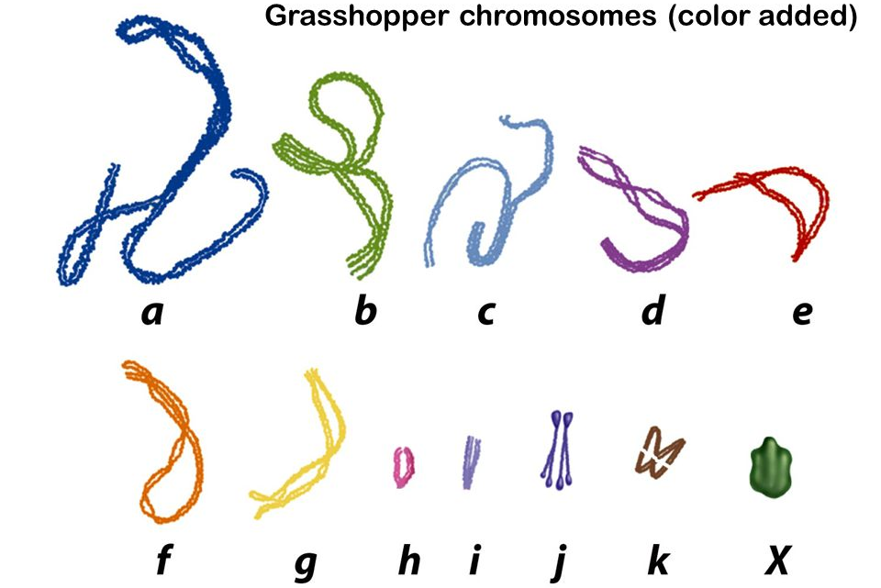
Chromosomes
Chromosome theory of inheritance:
Chr. comes in homologous pairs according to their size, with one inherited from mother and one from farther.
Walter Sutton

Slide 20
Chromosomes
Chromosome theory of inheritance:
Chr. of each pair synapse before meiotic division.
Synapsed Chr. separate during meiosis.
Walter Sutton

Slide 23
Chromosomes
Chromosome theory of inheritance:
His famous 1902 article “I may finally call attention to the probability that the association of parental and maternal chr. in pairs and their subsequent reduction constitute the physical basis of the “Mendelian law of heredity”.
Altogether both Boveri & Sutton laid the groundwork for “the chr. theory of inheritance.”
Walter Sutton

Slide 24
Chromosomes
Chromosome theory of inheritance:
Mendel’s law of segregation and assortment
Opened new area “Cytology and Genetics”
No definitive proof.
Walter Sutton
Theoder Boveri

Slide 25
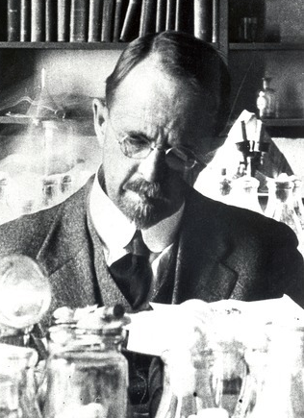
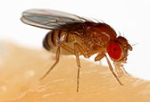
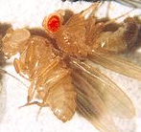
Chrmosomes
Experimental evidence of chr. inheritance:
An American evolutionary biologist, 1866, in Lexington, Kentucky.
Skeptical of chr. Theory
Worked on Drosophila melanogaster.
After breeding millions of flies, study genetics.
He observed fruit fly with white eyes instead of normal red eyes.
Thomas Hunt Morgan
X marks the spot

Slide 26
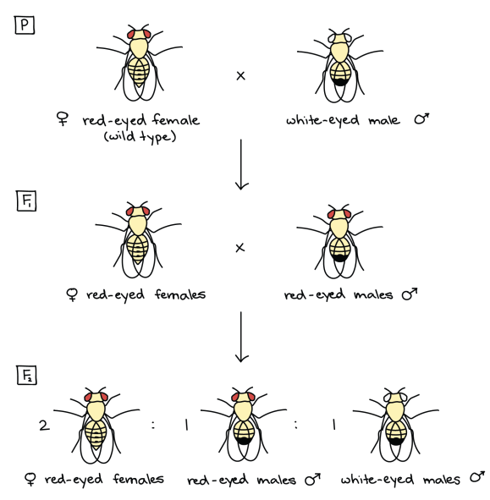
Chrmosomes
Experimental evidence of chr. inheritance:
Thomas Hunt Morgan
X marks the spot

Slide 27
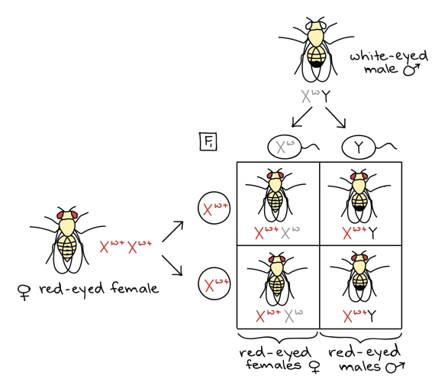
Chromosomes
Experimental evidence of chr. inheritance:

Slide 28
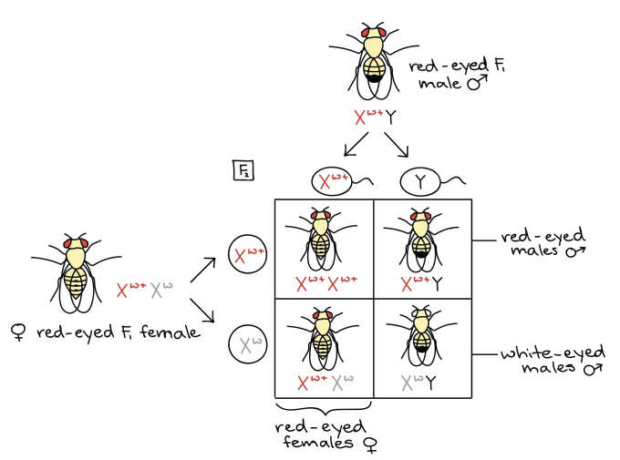
Chrmosomes
Experimental evidence of chr. inheritance:

Slide 29
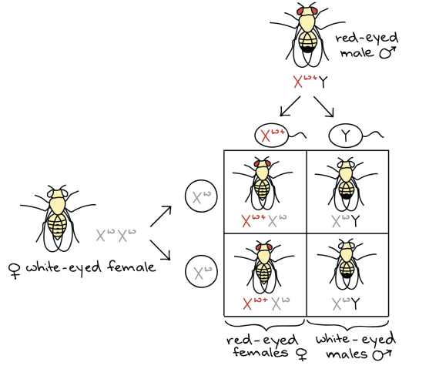
Chrmosomes
Experimental evidence of chr. inheritance:

Slide 30
Chrmosomes
History of finding hereditary on chromosomes:
1860s: Mendel proposed laws of inheritance that are independent of gametes
1875: The process of cell division in somatic cells or mitosis was discovered
1890: The process of reduction cell division in formation of gametes or meiosis was discovered
1900: Mendel is rediscovered by botanists Correns, de Vries, and von Seysenegg independently.
1902: The laws of inheritance and behavior of chromosomes are found to be parallel as noted by Walter Sutton, Theodor Boveri and others. They noted that chromosomes are paired in somatic cells, that reduction division or meiosis occurs within gametes, and finally that fertilization restores the paired status of chromosomes.
Early 1900s - Thomas Hunt Morgan from Columbia University confirms the presence of Mendel's inherited factors on chromosomes from Drosophila melanogaster or fruit flies. He also found sex chromosomes and sex linked diseases and traits.

Slide 31
Chrmosomes
Experimental evidence of chr. inheritance:
Strong confirmation that physical carriers of Mendel’s principle resides on chromosome.
Proves chromosome theory of inheritance.
Later Morgan’s student Bridges showed rare female and male with white eyes produced via non disjunction (failure to separate the chromosome).
Thomas H. Morgan

Slide 32
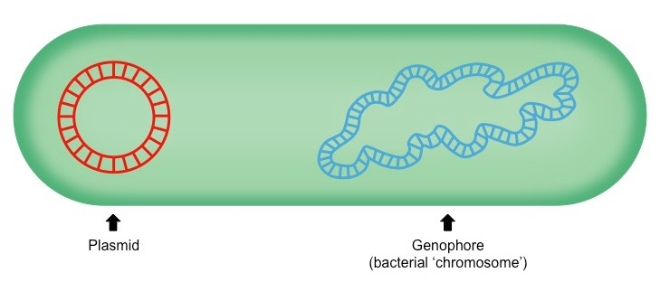
Chrmosomes
Hereditary Material in Prokaryotes:

Slide 33
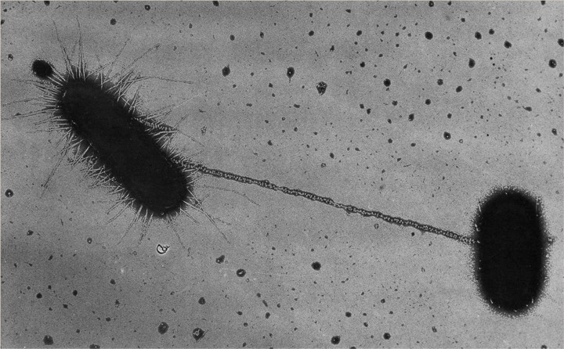
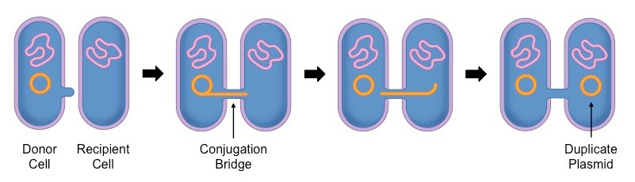
Chrmosomes
Hereditary Material in Prokaryotes:

Slide 34
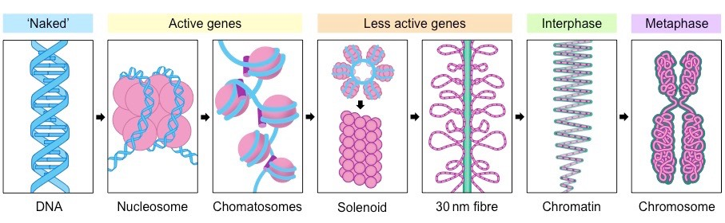
Chrmosomes
Organization of hereditary material in Eukaryotes:

Slide 35
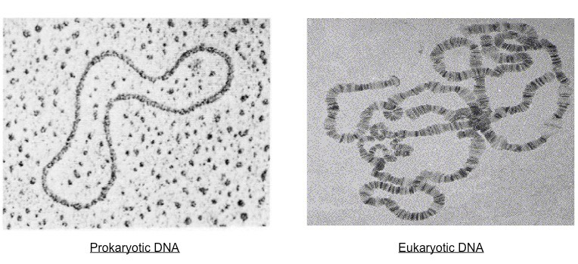
Chrmosomes
Prokaryotic vs Eukaryotic hereditary material:

Slide 36
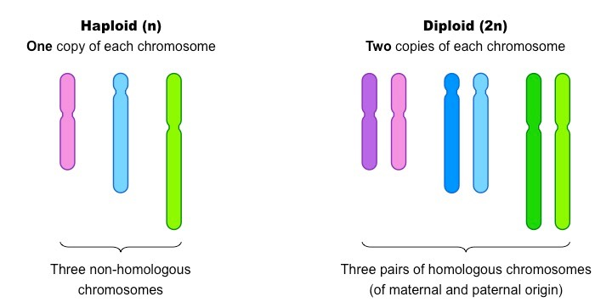
Chrmosomes
haploid vs Diploid:

Slide 37
Karyotyping
Karyograms:

Slide 38
Conclusions of Lecture-2
Chromosome theory of inheritance was not a work of single scientist.
a) Gregor Mendel: “possible system of heredity”.
b) Walther Flemming: “Discovery of chromosome” mitosis.
c) Theoder Boveri: “Meiosis / chr. defects”.
d) Walter Sutton: “chr. Individuality, meiosis, synapse”.
e) Thomas Morgan: Direct evidence, chr. = physical carriers.

Slide 39
Types of Questions?
Model organisms used by scientists?
No. of chr. in humans, flies, Ascaris, sea urchins?
What are haploids and diploids? Homologous chromosomes?
Percentage of male flies with white eyes in F1 Gen or F2 Gen?
What’s synapse?

Slide 40
Thank You!

